Slide 1
EMADE Framework for Automated Algorithm Design
Greg Rohling, Ph.D.
Greg.Rohling@gtri.gatech.edu
404-200-6539
Jason Zutty
Jason.Zutty@gtri.gatech.edu
404-407-8505
Date: 8/6/2018

Slide 2
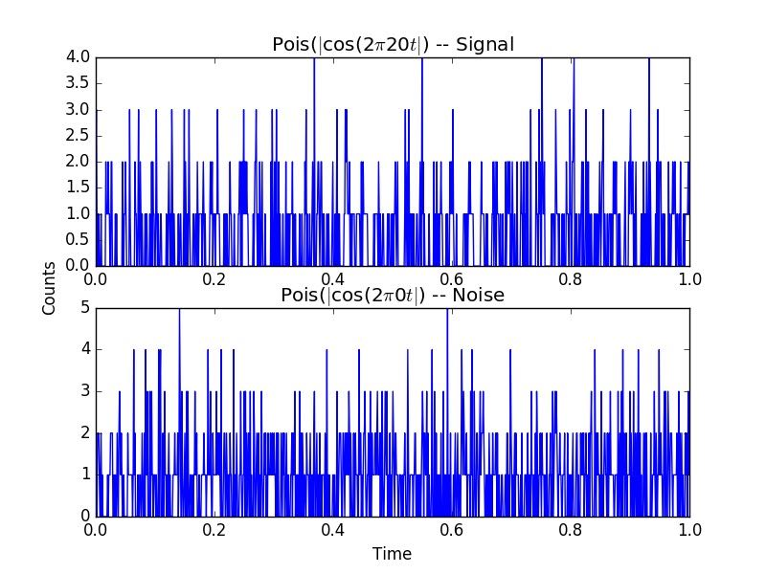
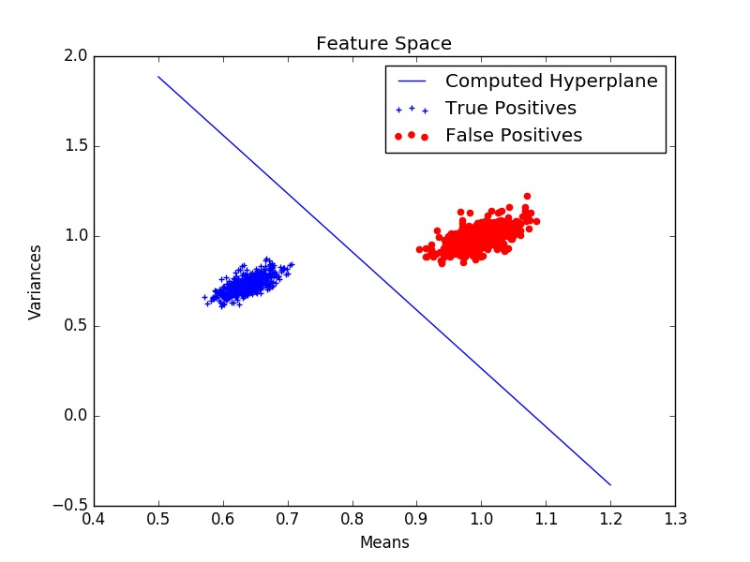
What is Machine Learning?
The process of allowing a computer to make a decision from a set of features that describe an observation
1000 POSITIVE signatures and 1000 NEGATIVE signatures plotted by mean and variance
An example POSITIVE signature
An example NEGATIVE signature

Slide 3
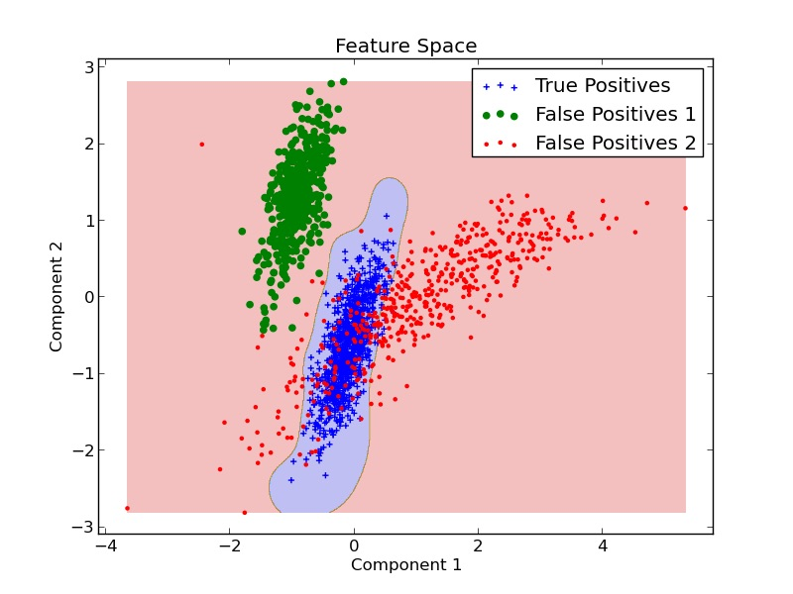
Machine Learning Continued
Machine learning excels by making more complicated decision rules than a human is capable of creating
This example algorithm draws the tightest boundary it can around our POSITIVE category while trying to include as few NEGATIVE sources as possible

Slide 4
How is a Machine Learning Algorithm Made?
Raw Data
Feature Engineering
Model Selection & Training
Data Preparation
Model Evaluation
Parameter Optimization
Model Deployment
Involves a number of steps

Slide 5
How is a Machine Learning Algorithm Made?
Raw Data
Feature Engineering
Model Selection & Training
Data Preparation
Model Evaluation
Parameter Optimization
Model Deployment
Involves a number of steps
PCA
FFT
Wavelet Transform
Scaling
Recursive Feature Elimination

Slide 6
How is a Machine Learning Algorithm Made?
Raw Data
Feature Engineering
Model Selection & Training
Data Preparation
Model Evaluation
Parameter Optimization
Model Deployment
Involves a number of steps
PCA
KNN
FFT
SVM
Wavelet Transform
Neural Network
Scaling
Decision Trees
Recursive Feature Elimination
Random Forest

Slide 7
How is a Machine Learning Algorithm Made?
Raw Data
Feature Engineering
Model Selection & Training
Data Preparation
Model Evaluation
Parameter Optimization
Model Deployment
Involves a number of steps
PCA
KNN
FFT
SVM
Wavelet Transform
Neural Network
Scaling
Decision Trees
Recursive Feature Elimination
Random Forest

Slide 8
How is a Machine Learning Algorithm Made?
Raw Data
Feature Engineering
Model Selection & Training
Data Preparation
Model Evaluation
Parameter Optimization
Model Deployment
Involves a number of steps
PCA
KNN
KNN
FFT
SVM
SVM
Wavelet Transform
Neural Network
Neural Network
Scaling
Decision Trees
Decision Trees
Recursive Feature Elimination
Random Forest
Random Forest

Slide 9
How is a Machine Learning Algorithm Made?
Raw Data
Feature Engineering
Model Selection & Training
Data Preparation
Model Evaluation
Parameter Optimization
Model Deployment
Involves a number of steps
PCA
PCA
KNN
KNN
FFT
FFT
SVM
SVM
Wavelet Transform
Wavelet Transform
Neural Network
Neural Network
Scaling
Scaling
Decision Trees
Decision Trees
Recursive Feature Elimination
Recursive Feature Elimination
Random Forest
Random Forest

Slide 10
How is a Machine Learning Algorithm Made?
Raw Data
Feature Engineering
Model Selection & Training
Data Preparation
Model Evaluation
Parameter Optimization
Model Deployment
Involves a number of steps
Each step represents a choice of one method from a large library of options
Each choice has a number of parameters that affect the performance
Overall this is a time consuming, iterative, and labor intensive process

Slide 11
Scoring the Algorithms
Each point represents the overall performance of one algorithm
False Negatives
Trying to push toward origin
False Positives

Slide 12
Scoring the Algorithms
Three of these algorithms form an optimal set because they are non-dominated
False Negatives
False Positives

Slide 13
Evolutionary Multi-objective Algorithm Design Engine
Synthesizes new algorithms from existing building blocks
Evaluates hundreds of thousands of algorithms in the time a data scientist could try a dozen
Simultaneously optimizes against multiple performance criteria
Initialized by the state of the art
Raw Data
Feature Engineering
Model Selection & Training
Data Preparation
Model Evaluation
Parameter Optimization
Model Deployment
Raw Data
Data Preparation
Model Deployment
EMADE

Slide 14
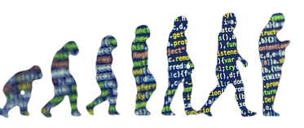
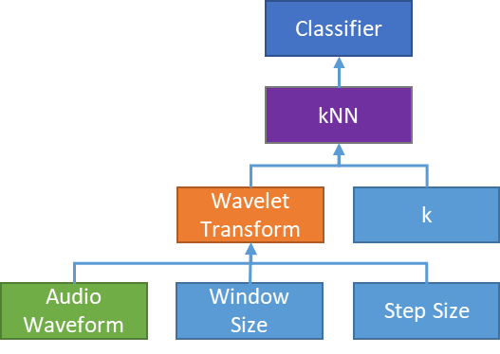
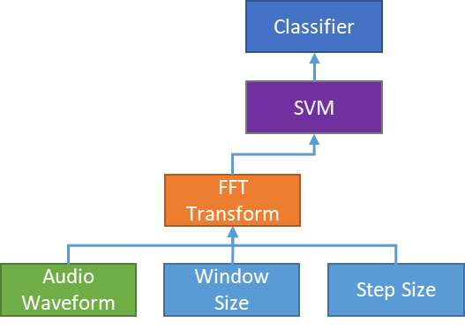
Evolutionary Multi-objective Algorithm Design Engine
EMADE applies concepts from biology such as “survival of the fittest” and “DNA” to the world of software to evolve algorithms tailored to a specific dataset and problem
Metric 1
“Generation 1”
Composite Algorithms
Metric 2
Notes:
Totally illegible from my seat. We need a better gene pool allegory picture set.

Slide 15
Evolutionary Multi-objective Algorithm Design Engine
EMADE applies concepts from biology such as “survival of the fittest” and “DNA” to the world of software to evolve algorithms tailored to a specific dataset and problem
Metric 1
“Generation 1”
Crossover
Metric 2
Notes:
Totally illegible from my seat. We need a better gene pool allegory picture set.

Slide 16
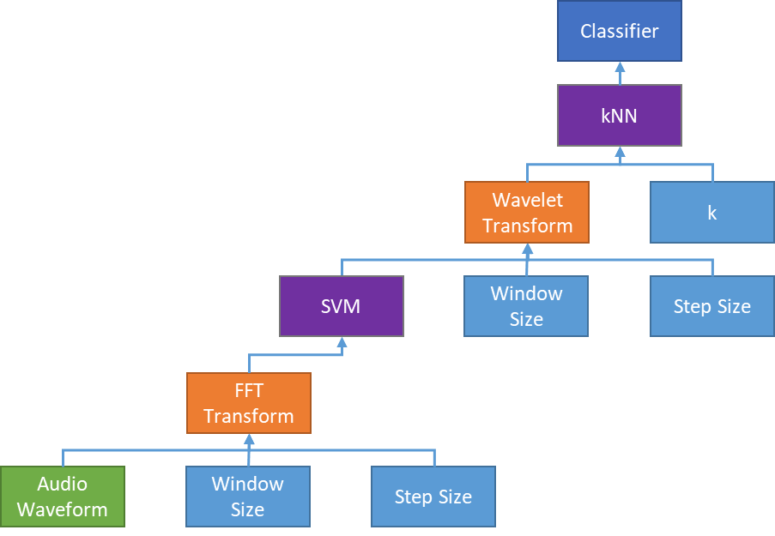
Evolutionary Multi-objective Algorithm Design Engine
EMADE applies concepts from biology such as “survival of the fittest” and “DNA” to the world of software to evolve algorithms tailored to a specific dataset and problem
Child Algorithm
“Generations 1 & 2”
Metric 1
Child algorithm now forms Pareto front
Metric 2
Notes:
Totally illegible from my seat. We need a better gene pool allegory picture set.

Slide 17
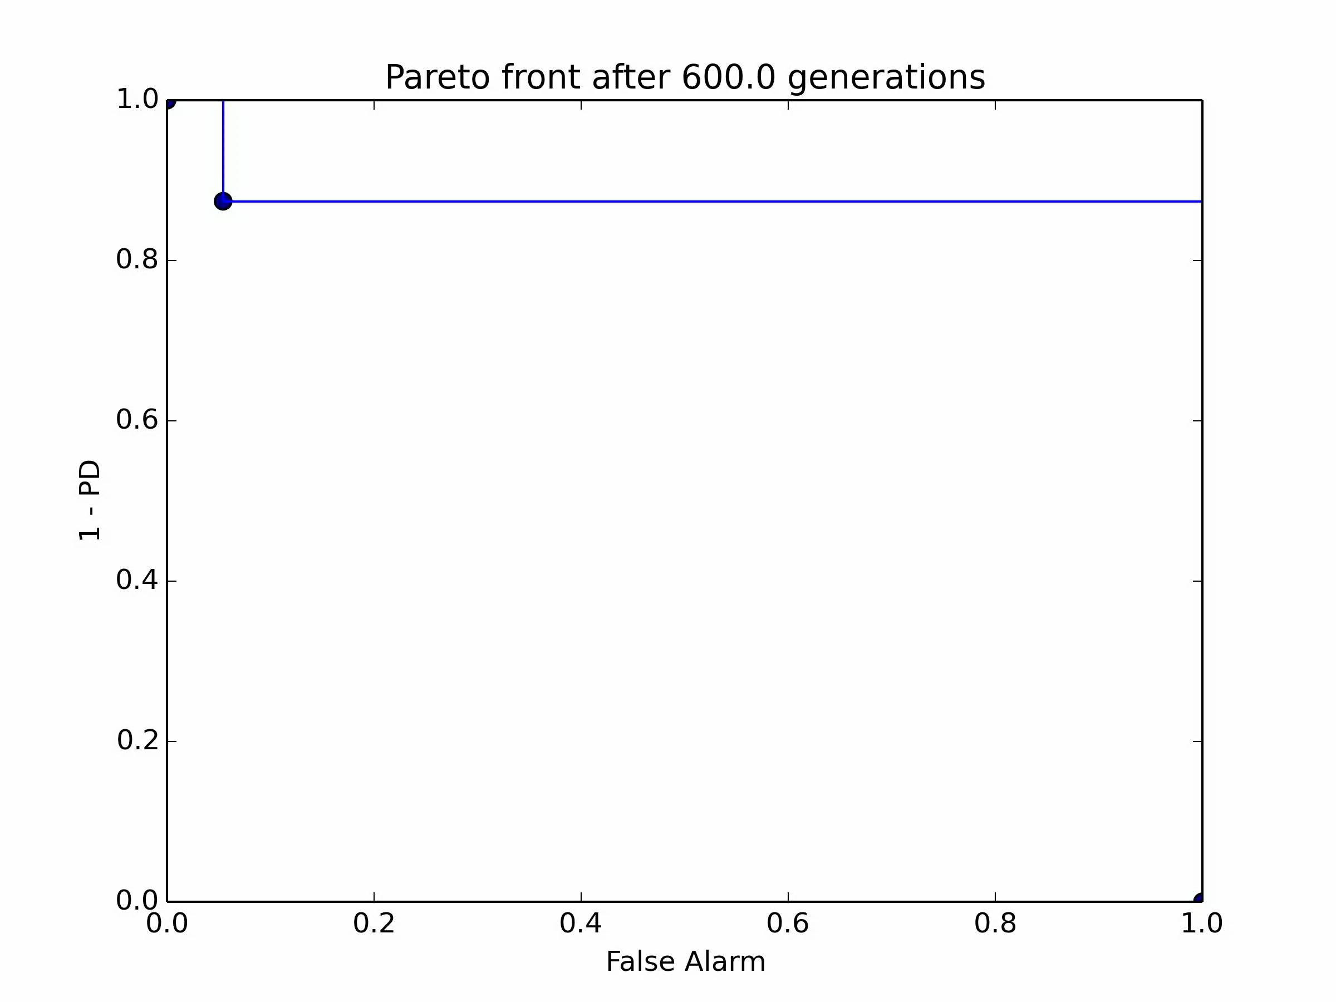
Evolution In Action
False Negatives
False Positives

Slide 18

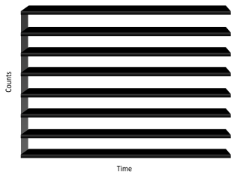
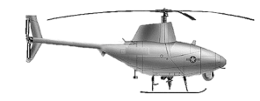

Example Application – Bathymetric LIDAR
Task: Estimate the optical path length (OPL) in meters from the sea surface to the sea floor
19th Annual JALBTCX Coastal Mapping and Charting Workshop
Title: Reducing Total Propagated Uncertainty through Evolutionary Multi-objective Algorithm Design
Authors: Domenic Carr, Jason Zutty, Joseph Mosby, James Rick, Greg Rohling, Ryan James, and Christopher Valenta
D

Slide 19
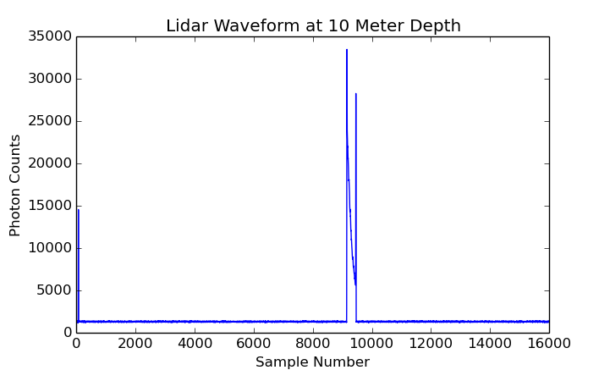
Interest Point Method
Industry standard for optical path length estimation
Look for inflection points preceding peaks to compute optical path length in water
Peaks round out with reflections, noise can influence where peak is detected
Three Steps
Smooth LIDAR waveform
Detect Peaks
Perform informed search to find inflection points

Slide 20
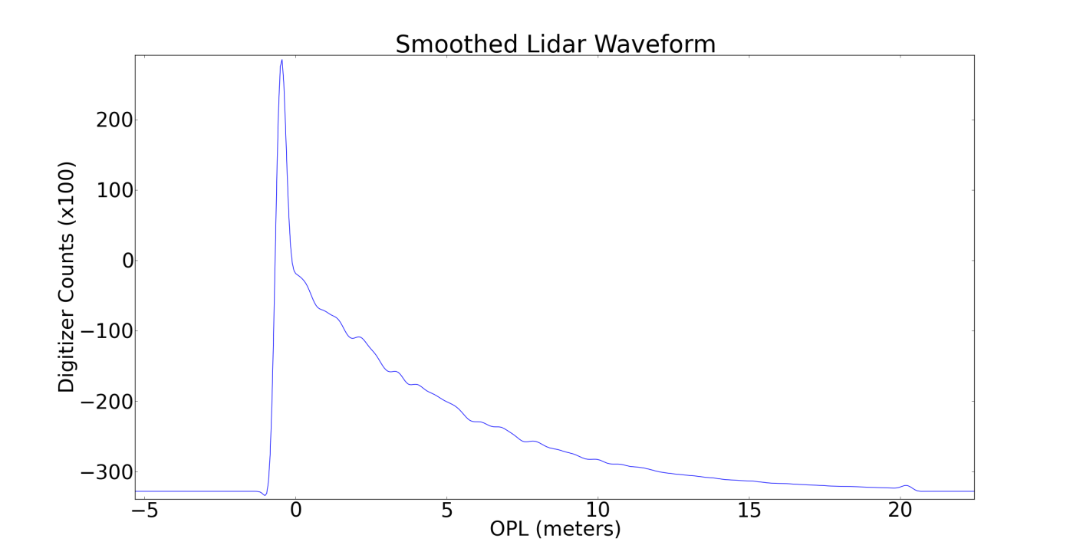
Smoothing the Waveform
Uses a Savitzky-Golay polynomial filter

Slide 21
Peak Detector
Finds peaks based on relative strength of nearby points

Slide 22
Informed Search
Finds inflection points preceding the peaks using zero crossings

Slide 23
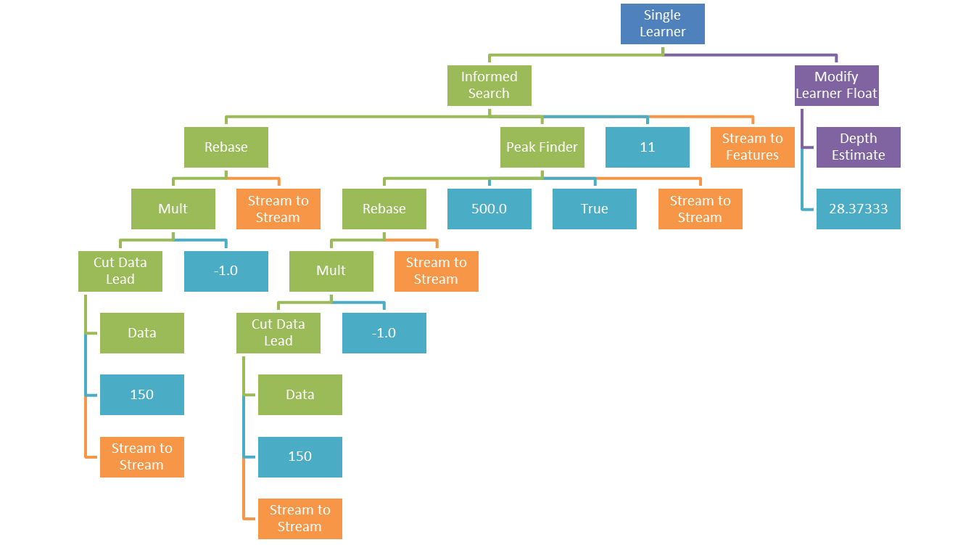
Seeding EMADE – Interest Point Detection
Best human derived algorithms are implemented to seed EMADE evolutionary process

Slide 24
Seeding EMADE
Implemented state-of-the-art techniques from literature as EMADE building blocks
Built trees for EMADE using these methods
Richardson-Lucy Deconvolution
Waveform Supersampling
Matched Filtering
B-Spline Deconvolution
Gradient Boosting Regression
Discrete Fourier Transform
Data
Max Depth = 3
Waveform Supersampling
Learning Rate = 0.1
Number of Estimators =100
Stream to Stream
Gaussian
Fitting
Gaussian Decomposition
Lognormal Fitting
Create 7 seed trees by inserting
methods here
Using more human derived primitives to continue improvements

Slide 25
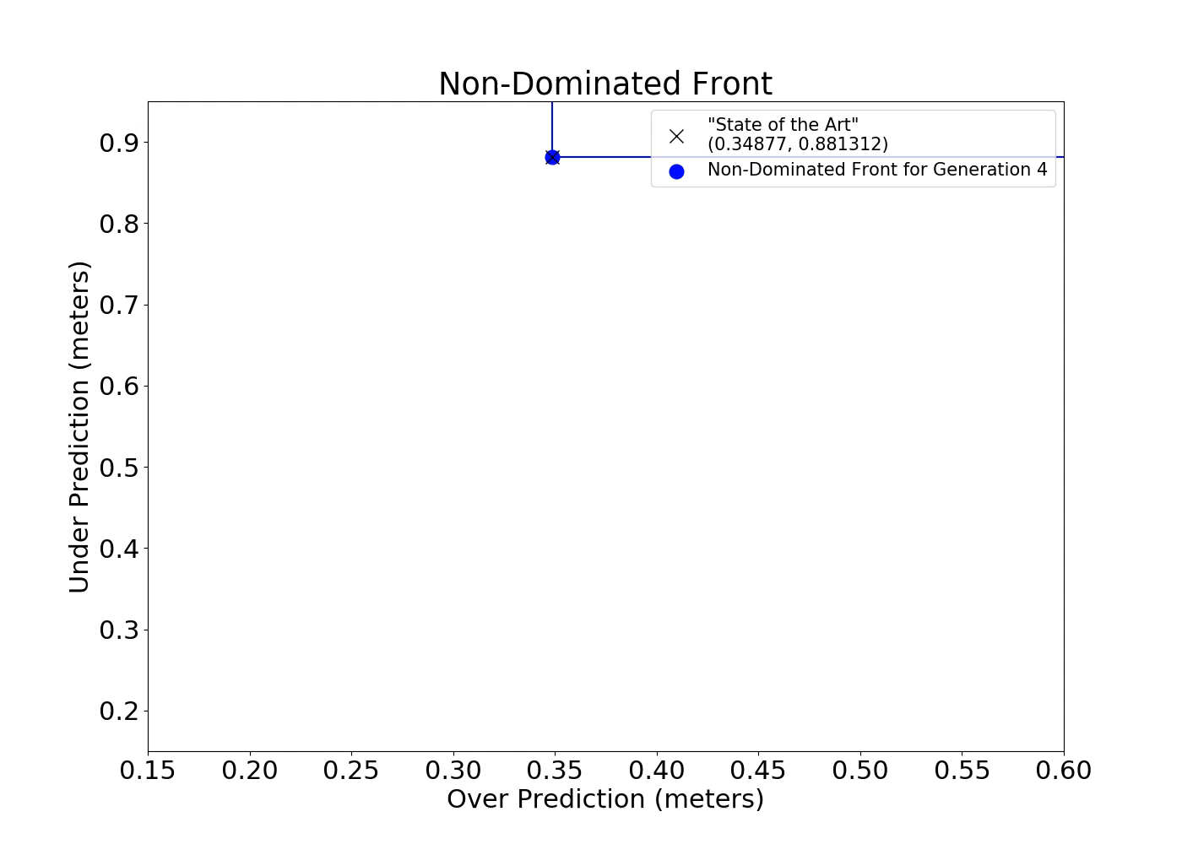
Results
After evolution
Over prediction from 0.34 meters to 0.27 meters (20.5% Improvement)
Under prediction from 0.88 meters to 0.26 meters (70.4% Improvement)
Evolutionary process creates solutions that out perform existing human derived algorithms

Slide 26
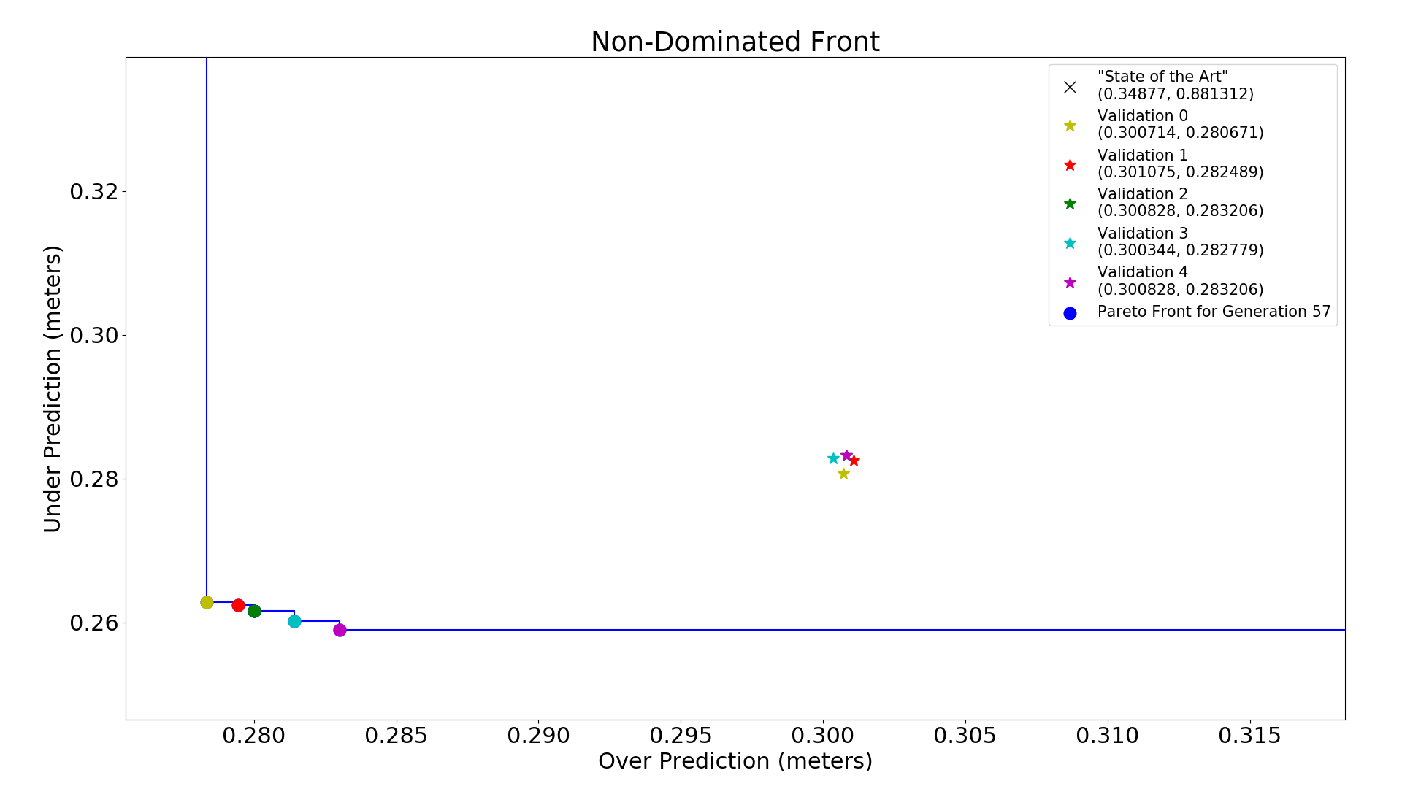
EMADE Evolved Individuals
Single Learner
Integral
Integral
Inverse Discrete Fourier Transform
Integral
Erosion Ellipse
Data
4
85
3
Boolean
Stream to Stream
Stream to Features
Feature To Features
Orthogonal Matching Pursuit
(0.2783, 0.2628)
Single Learner
Orthogonal Matching Pursuit
Erosion Ellipse
Add Scalar Float
Integral
Erosion Cross
Data
4
-3
6
True
Stream To Features
Float Subtree
5
Integer Subtree
5
True
57 Generations represents ~30,000 experiments completed
(0.2800, 0.2616)

Slide 27
EMADE Evolved Individuals
Single Learner
Integral
Erosion Ellipse
Data
4
85
3
Boolean
Stream to Features
Orthogonal Matching Pursuit
(0.2783, 0.2628)
Single Learner
Integral
Erosion Cross
Data
4
-3
6
True
Stream To Features
Orthogonal Matching Pursuit
(0.2800, 0.2616)
57 Generations represents ~30,000 experiments completed

Slide 28



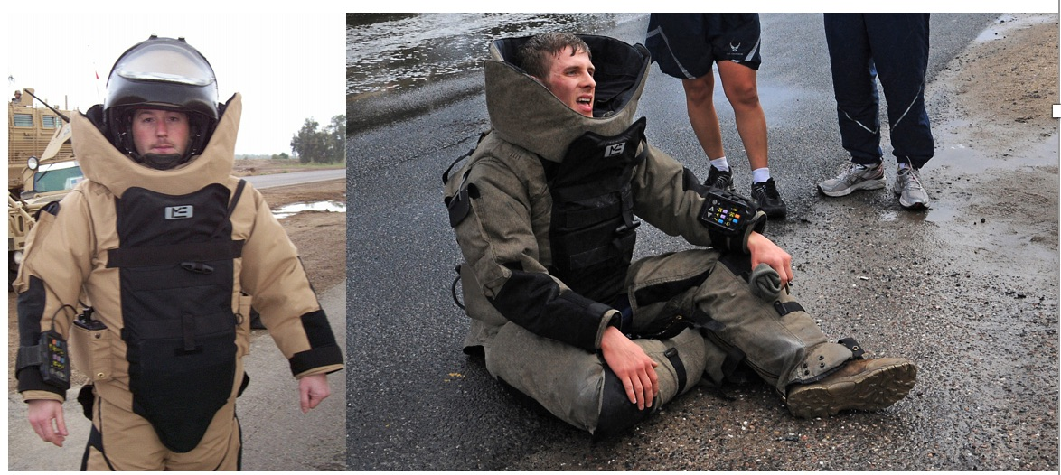
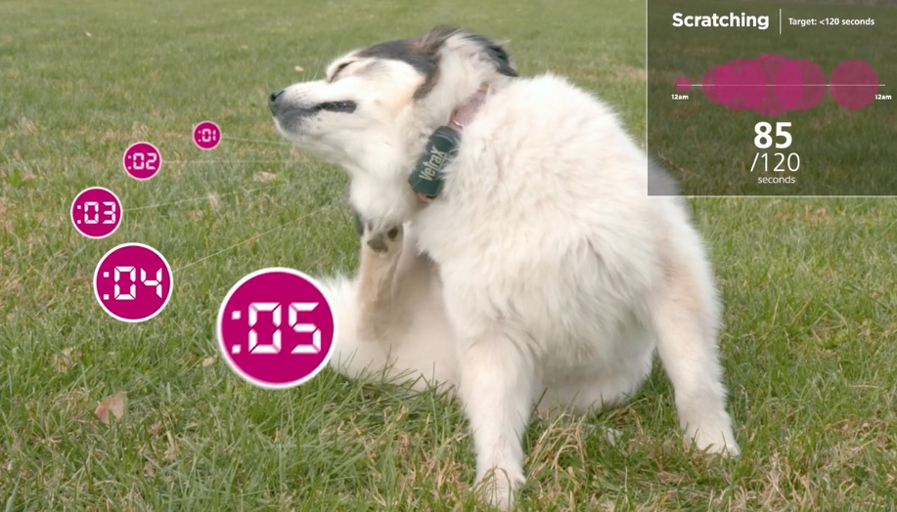
EMADE Successes
Better mission planning for first responders = Lives saved
Objective measurements of behaviors = A voice for dogs

Slide 29
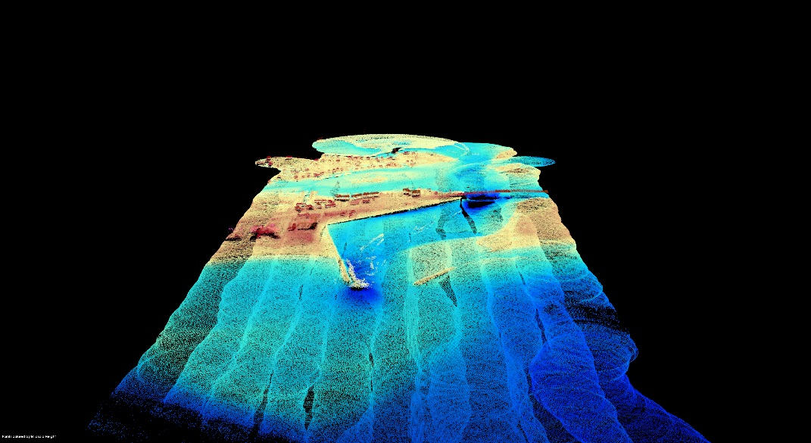
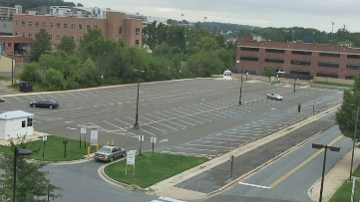
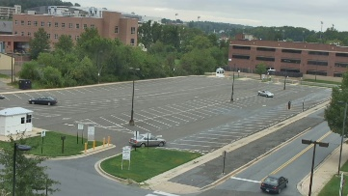
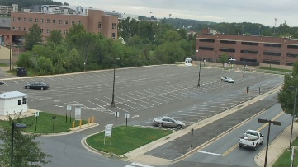


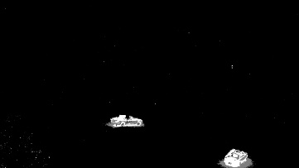


Expanding EMADE’s Applicability
Imagery
3D Point Clouds
Our vision is to be able to apply EMADE to all domains that pose challenging problems for researchers
Intelligence Surveillance and Reconnaissance
LIDAR Point-Cloud Processing
Video
Categorical
Automated Vehicle & Personnel Detection
Radar Emitter Classification

Slide 30
Recent Effort: xView Challenge
Open overhead imagery challenge with a large dataset
1 Million object instances
60 Different object classes
We used the data to implement a binary classifier for buildings
Carved imagery into 224x224 pixel image chips
Predict a 1 when building in chip, 0 otherwise.
Imagery
Intelligence Surveillance and Reconnaissance

Slide 31
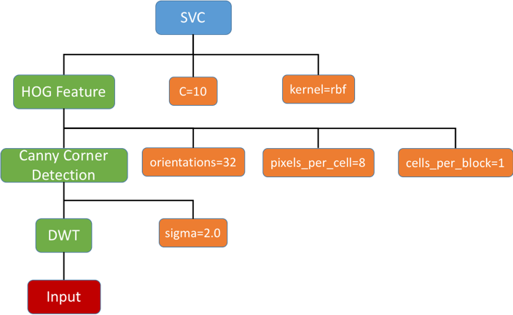
xView Preliminary Results
An evolved solution produced by EMADE with false positive rate of 2.85% and false negative rate of 5.75%
EMADE outperforms traditional computer vision techniques, but needs to implement new neural network methods as primitives

Slide 32
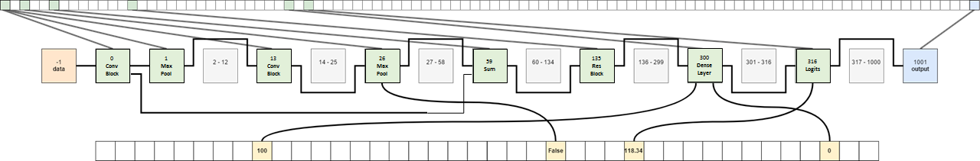
Path Forward: Deep Neural Networks
Several different ways that DNN’s can play a role in EMADE
Implement pre-trained models as classifiers
Train pre-trained models using transfer learning
Optimize architectures and hyperparameters
We recently began exploring all three paths forward for the “Army Signal Challenge”, which involves classifying different RF signals.

Slide 33

Augmenting Analysts with AutoML
Raw Data
Random sampling of data fed directly to analyst
Data fed to algorithm produced by EMADE
Algorithm elevates data with detections to analysts
Analysts
Optimized Algorithm
EMADE produces algorithms that can be used interchangeably to detect or track objects of interest in raw data
Samples where analysts’ predictions differ from EMADE-developed algorithm’s predictions used for new optimizations
EMADE
EMADE quickly adapts to new challenges as soon as new data is available

Slide 34


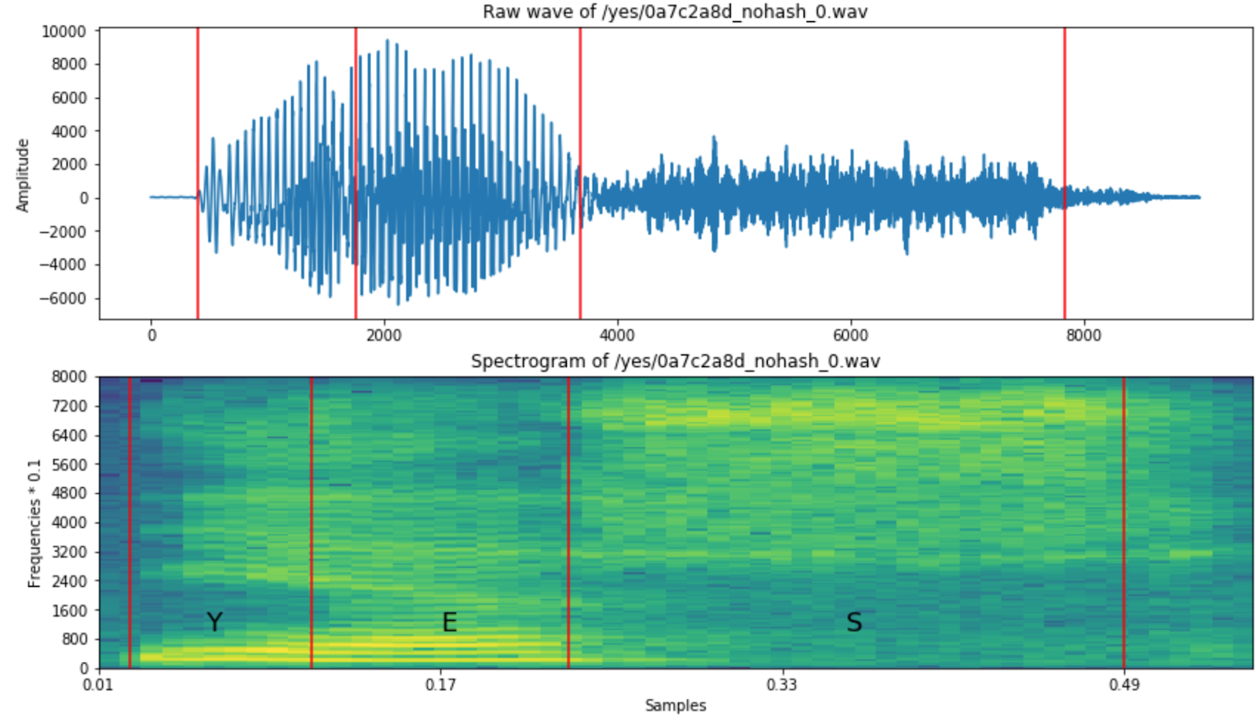
Vertically Integrated Projects
Largest VIP team of 35 students, 50+ students expected this fall
Active development and application of our EMADE framework
Resulted in 10 student assistants already deeply familiar with our work
4 hold clearances
Quantitative Financial Analysis
Natural Language Processing
Speech to Text

